Slide 1
The Winning Platform
Jim Gochee

Slide 2


Notes:
Biggest trend affecting our customers today.
Ruby on Rails is changing the way developers build software.
AND Our mission – help make ruby on rails websites faster.
[Pause]
I’m joking of course. But in 2008, this was the world as we saw it.

Slide 3

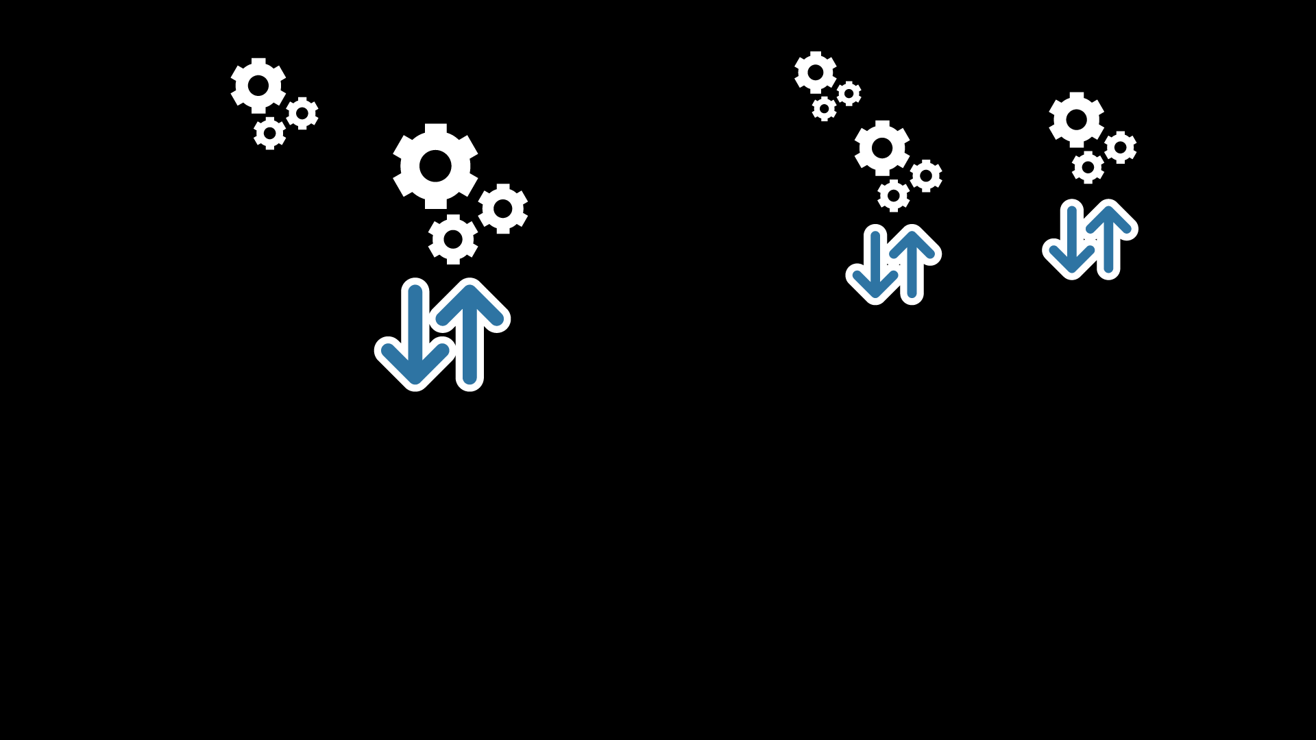


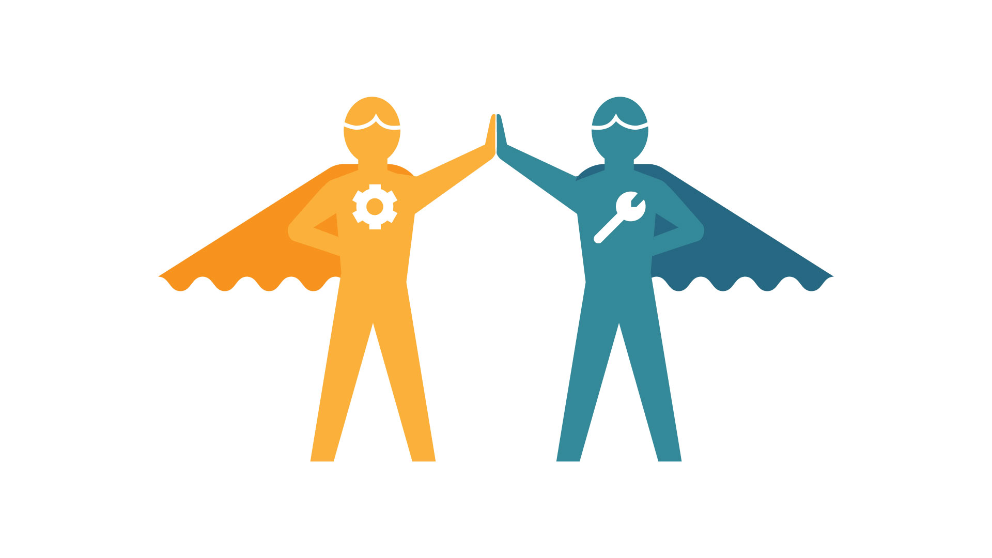


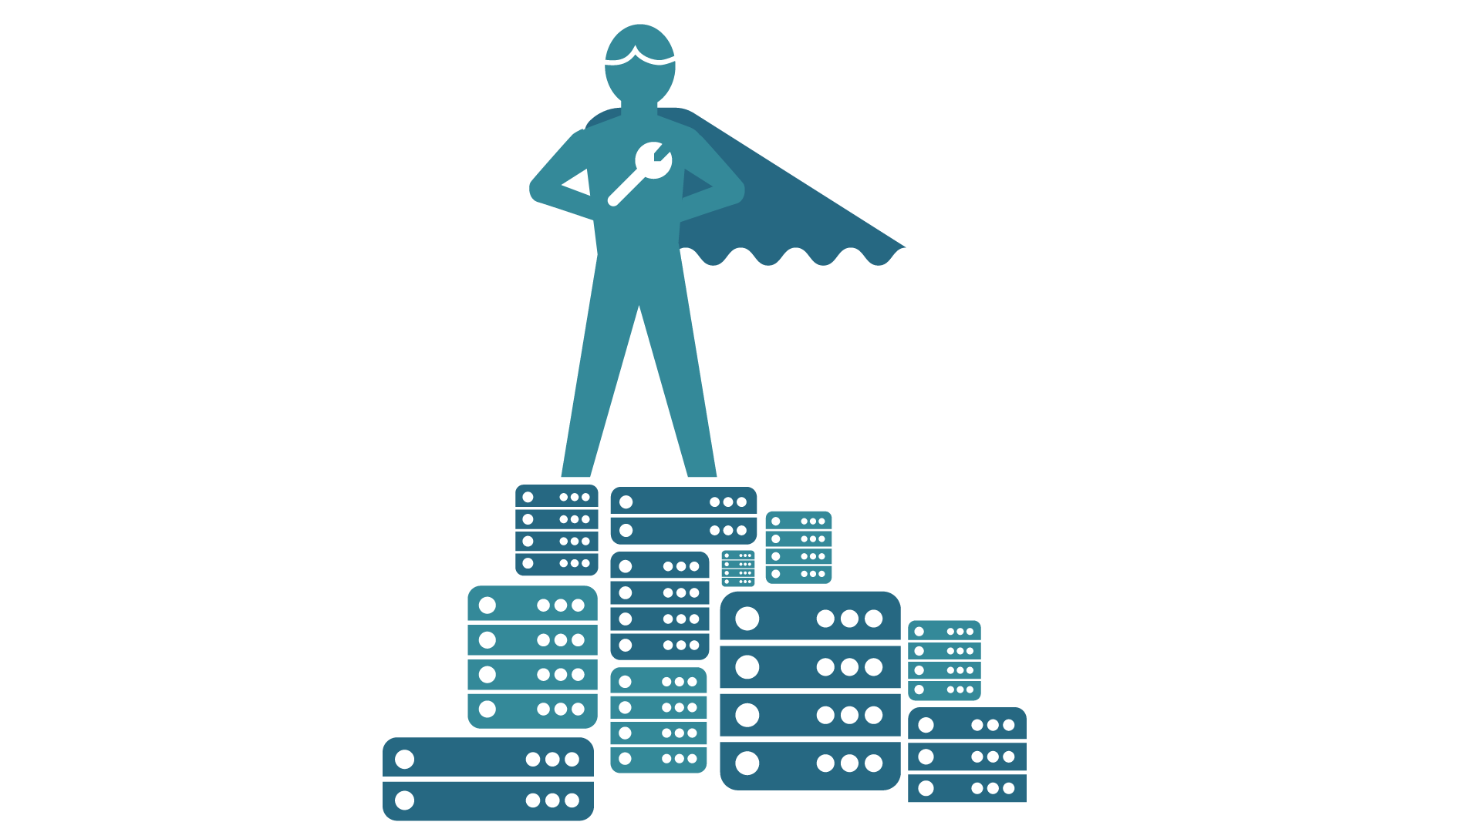

Notes:
This is really what’s happening – 8 mega trends
Mobile – people spend almost 3 hours a day on their phones. Apple generates as much revenue through mobile purchase as they do through desktop web browsers.
Social – transparent, authentic. There’s no place for bad experiences to hide.
Cloud – don’t trust the cloud, without New Relic. Lots of opportunity for speed of implementation, lots of risk
Big Data – businesses want to serve their customers better and they want to use data to help make decisions
Developers – King makers. Once relegated to working on systems that support the business, developers hold the keys to the business
Agile – if your business depends on software, then you’ll want to use modern software development techniques to move quickly. Speed
Dev/Ops – another result of this transformation. Operations teams are having to adapt to increasingly complex infrastructure by managing the problem with software.
SaaS – and finally, it excepted, and expected, that pure multi-tenant SaaS is the superior software delivery model.

Slide 4

Notes:
We are in the middle of this.
Each of these trends on their own would be one thing, however combined they are an absolute tidal wave of change.
Digital Revolution. Every company, every company, is trying to figure out how they fit into the modern Internet world. Business models are being turned upside down. Entire industries are being shaken to their core.

Slide 5
Product First
Customer Value
Pure SaaS
Ubiquity
5
Notes:
Why are we in the middle of this? Hold that thought for just one minute…
Before we talk about the product we have today, who are we?
Product First – This is why I am here. I love great products. Apple dream job. People matter – Magical experience. Prerequisite for a great business. Connect to the heart, not just to the mind. Customers fall in love with us.
Pure SaaS – Uncompromising in this belief. Pure SaaS, not On-Prem, Off-Prem, Both - garbage. Agile. Low friction. Simple. Easy. Speed of innovation. Business Model Efficiency.
Ubiquity – Democratizing Enterprise Software. Making a Big Impact. Low Friction is critical.
Who Wins? The customer. They get the best product with the lowest total cost of ownership.
These are powerful. Nobody in our market looks like us. Unfair Natural Advantage.
This formula is inspiring companies to be like us.

Slide 6
Application Performance
Customer Experience
Business Success
Notes:
Customer Value – breaks down into three buckets

Slide 7
Application Performance
Customer Experience
Business Success
Multi-Tenant SaaS Architecture
Security
Auto-Upgrades
Scalability
Notes:
Here’s the amazing thing we have today
Seven years in the making
Last year, 3 new products
We’re calling this our SW Analytics Platform

Slide 8
In one minute at New Relic…
219
Million time slices
14,223
113
Queries answered
54
16
Million analytics events
32/ms
Gigabytes of data
Million external HTTP requests
70
Average query time
Billion analytic events scanned
Notes:
Hundreds of thousands of Users rely on us.
The platform scales.
Every 5 minutes we fill up the hard drive that comes in your laptop

Slide 9
Developer 89%
Architect 11%
DevOps 45%
Ops 55%
Notes:
We’re not just a Developer’s best friend.
IT Ops people love us as well
As do company executives – Strategic
THIS IS IMPORTANT

Slide 10






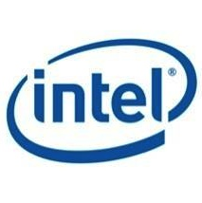

























Disruptors
Large Global Enterprises
Notes:
We serve companies of all sizes

Slide 11

130 legacy software products
Move to SaaS
Brand
Be Like New Relic
11
Notes:
The most interesting story of the year
Background
Corporate mandate to rewrite all 130 of their legacy software products.
Realization – they chose us not because of our current product functionality. They chose us because we represent what they want to become. They believe in our core principles

Slide 12
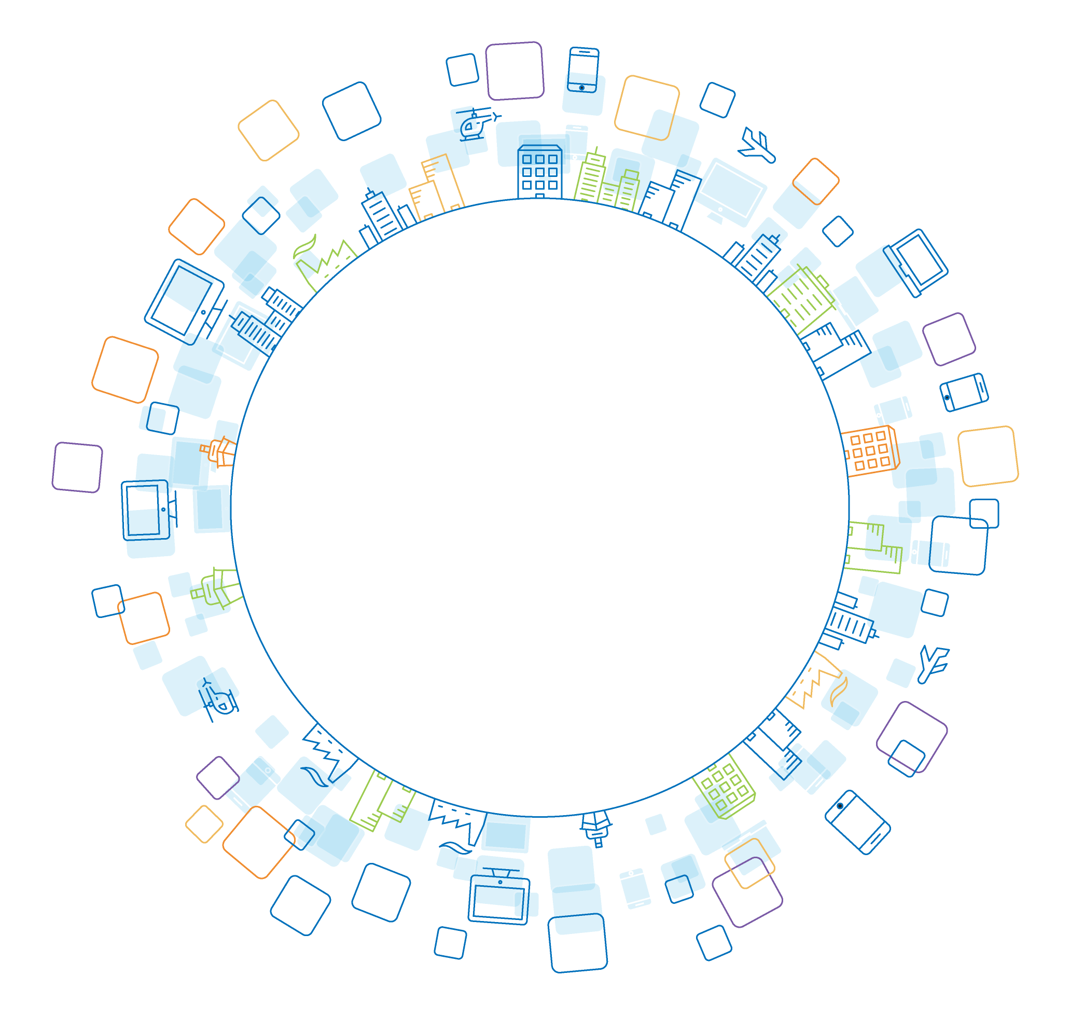
In Five Years…
Our platform is all that’s needed to operate a modern digital experience
Notes:
Bold vision of the future

Slide 13
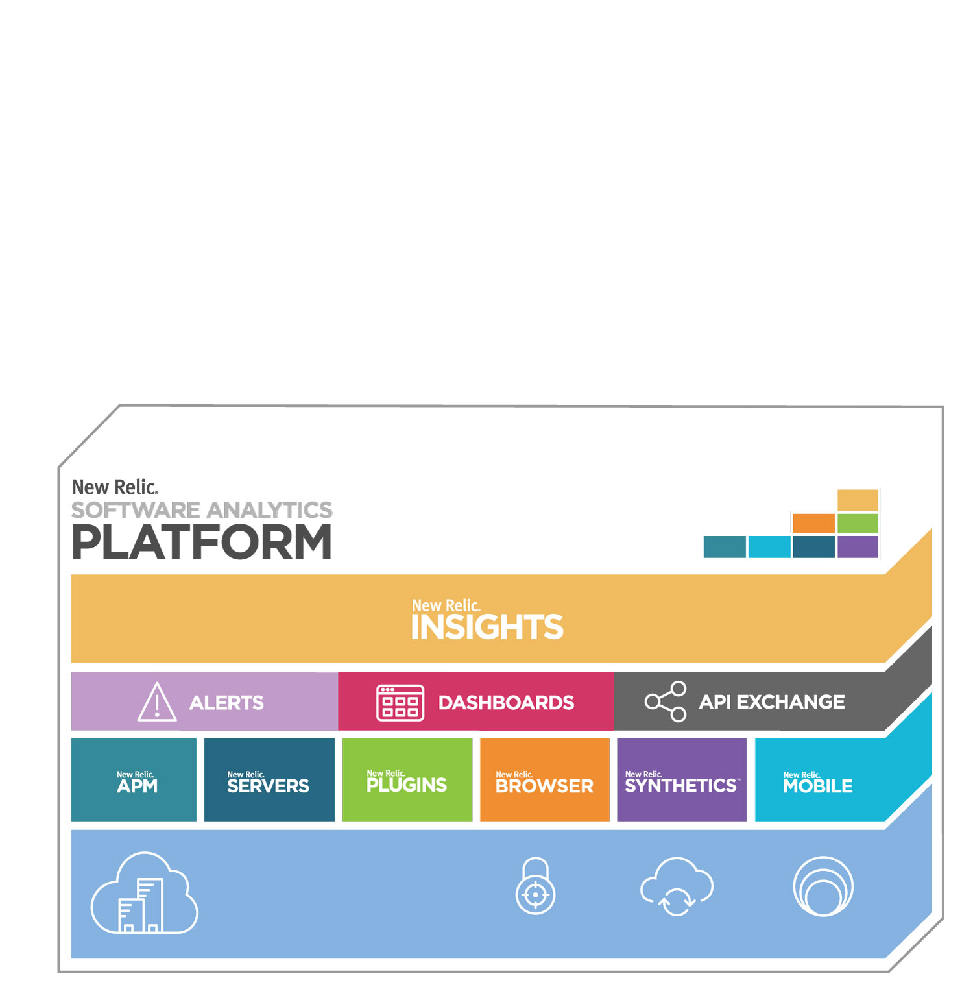
Multi-Tenant SaaS Architecture
Security
Auto Upgrades
Scalability
Notes:
Here’s how it plays out

Slide 14
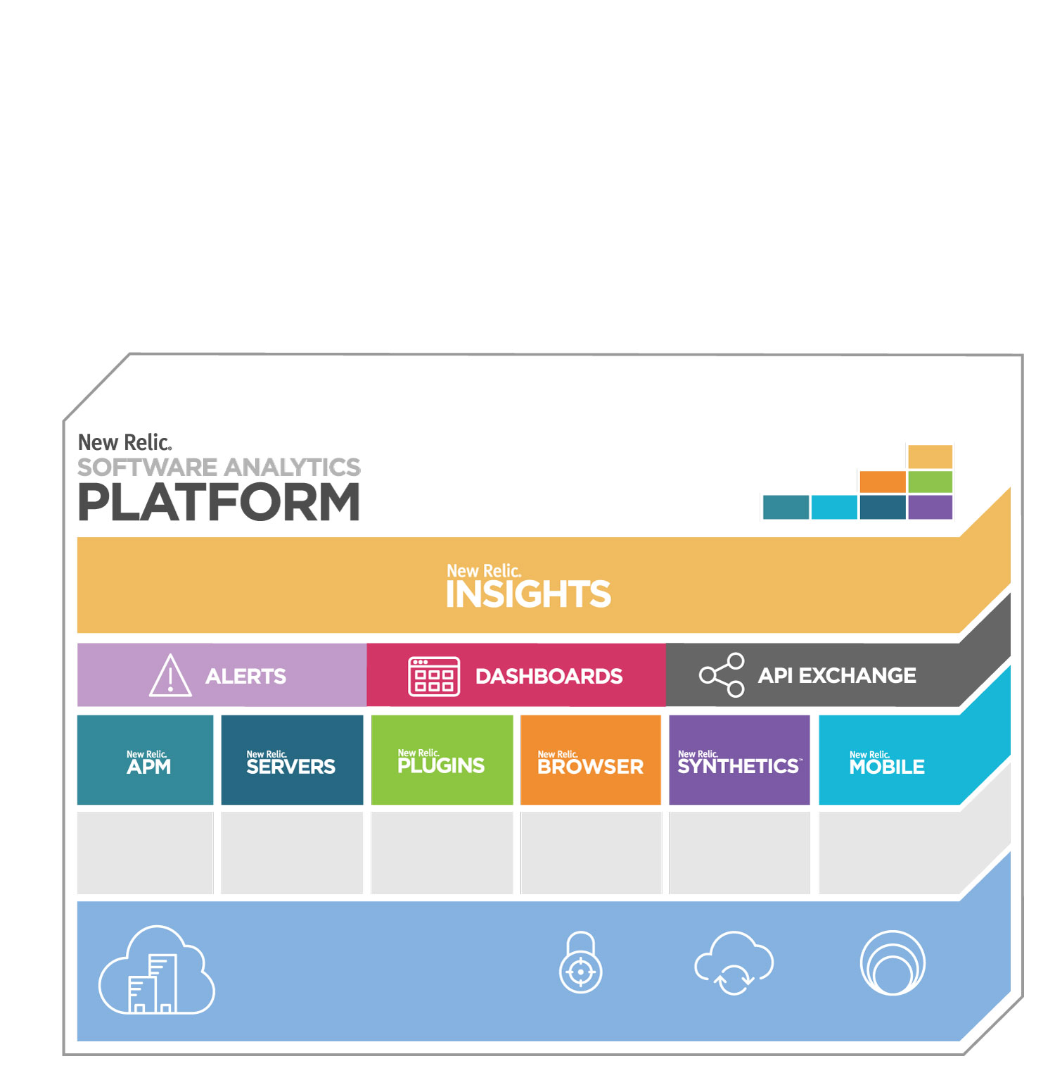
Application Performance Analytics
Security
Multi-Tenant SaaS Architecture
Security
Auto Upgrades
Scalability

Slide 15
Infrastructure Analytics
Logging
Server Pro
APM Analytics
Multi-Tenant SaaS Architecture
Security
Auto Upgrades
Scalability

Slide 16
Customer Analytics
User Analytics
Web Analytics
Security Analytics
APM Analytics
Infrastructure Analytics
Multi-Tenant SaaS Architecture
Security
Auto Upgrades
Scalability

Slide 17
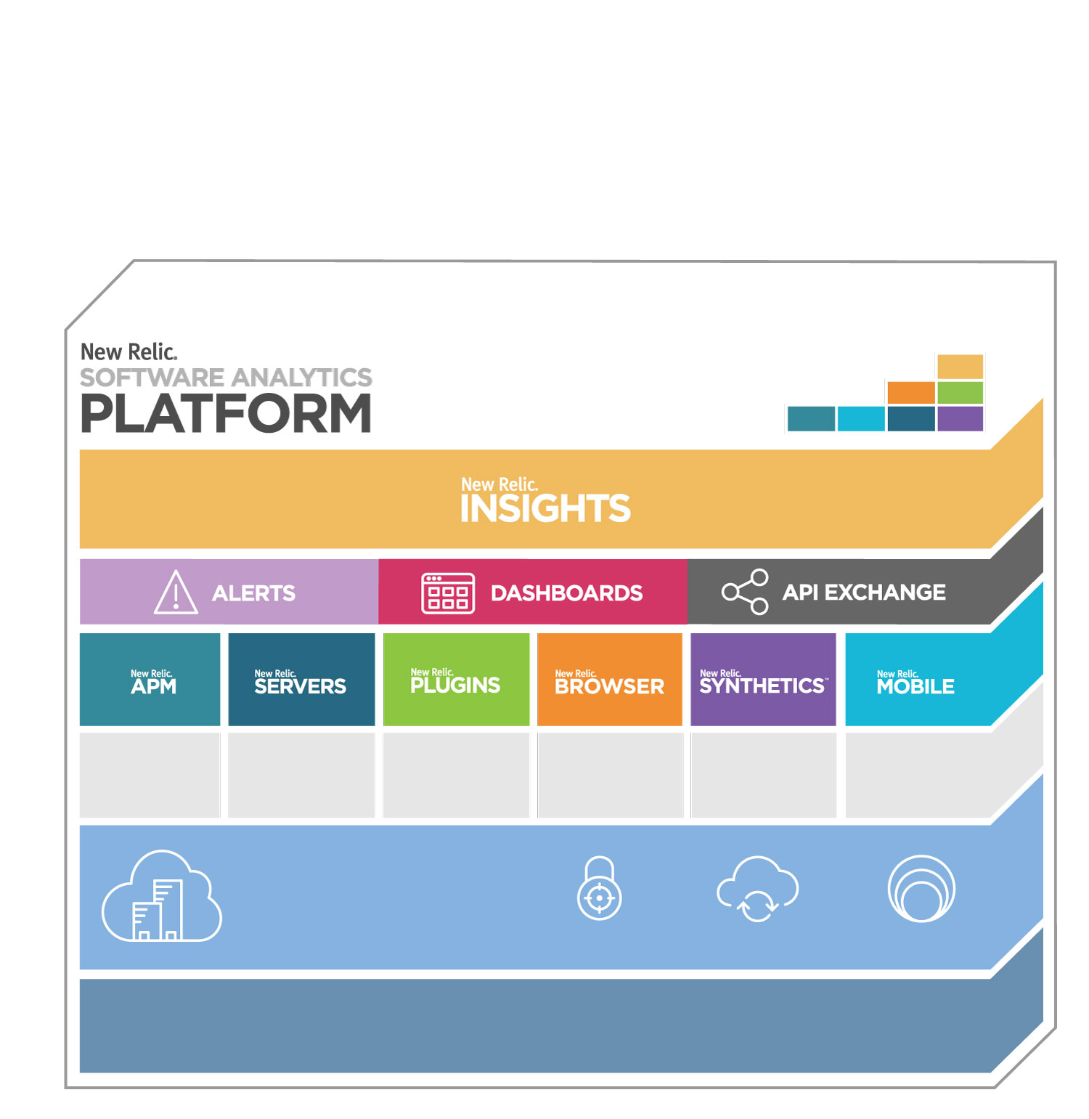
Platform Expansion
Third Party Data Apps
APM Analytics
Infrastructure Analytics
Customer Analytics
Multi-Tenant SaaS Architecture
Security
Auto Upgrades
Scalability

Slide 18
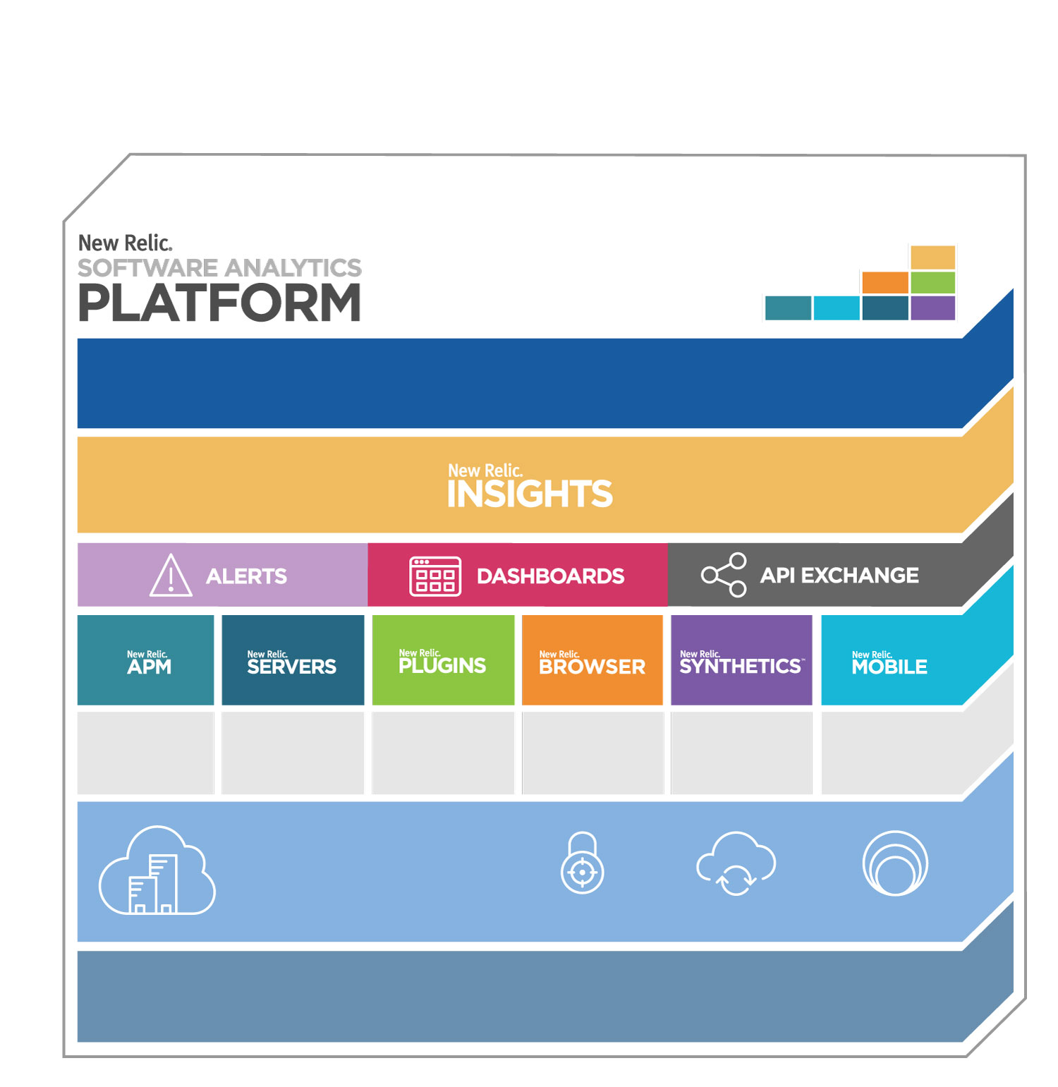
Business Analytics
Business Analytics
Revenue Analytics
Marketing Analytics
Customer Support
APM Analytics
Infrastructure Analytics
Customer Analytics
Multi-Tenant SaaS Architecture
Security
Auto Upgrades
Scalability
Platform Expansion

Slide 19
3 statements -Andrew will send language
Remove interstitial
Clean page with logo bug see thank you slide
FY16 ROADMAP

Slide 20
Remove Friction
Cloud Friendly Pricing
Bundles
Signup flow overhaul
Cross-Product promotion
Demo environment
Notes:
Friction is the silent killer because it’s true impact is impossible to measure.
I find myself more sensitive to it these days because things are getting so much easier.
Airline check-in and boarding ticket on the phone vs. having to check-in at a kiosk
[Talk to each point]

Slide 21

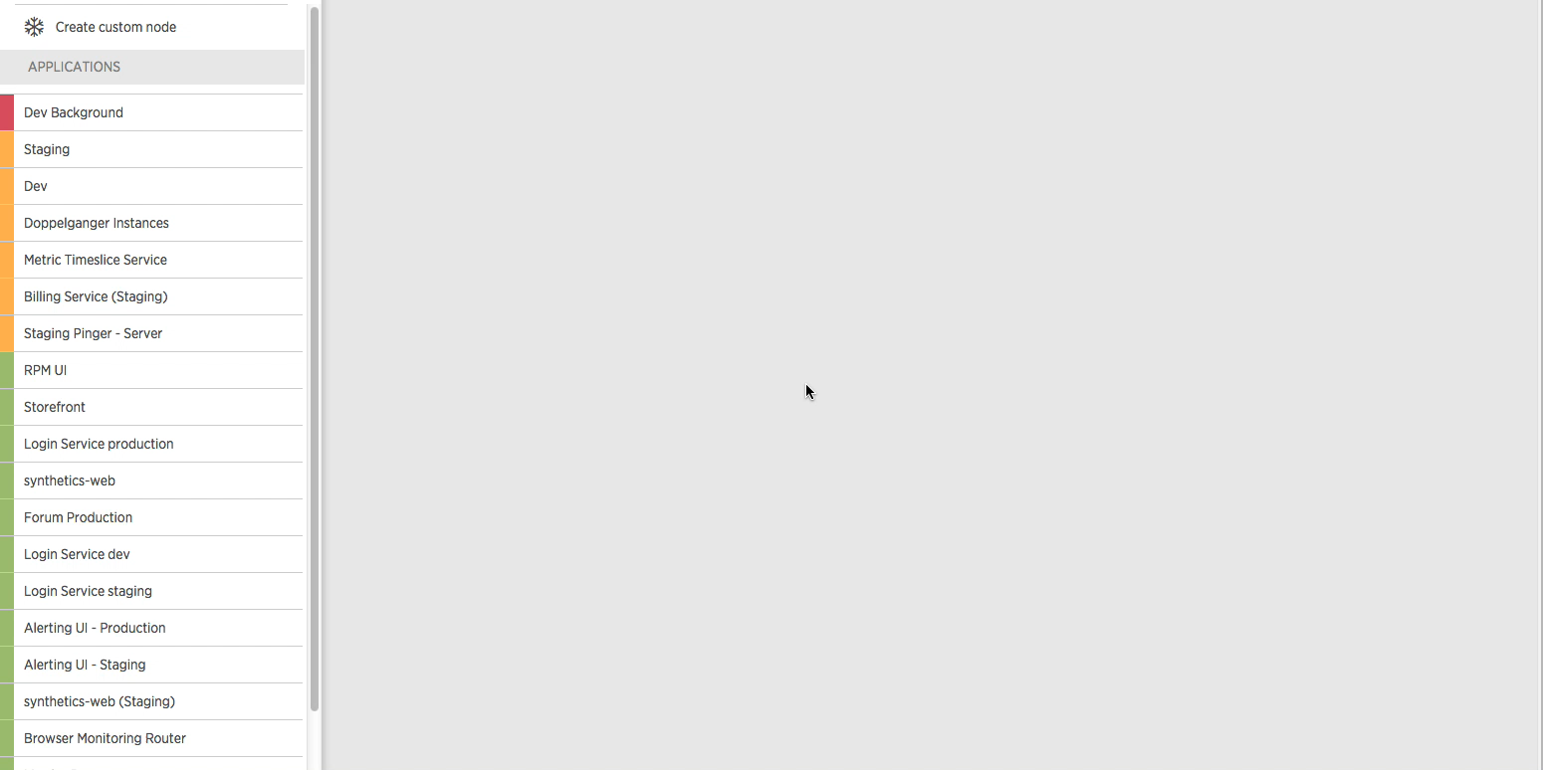
Application Performance
Notes:
Service Maps
Customers care about this because they often manage many internal web services that connect in complex ways.

Slide 22
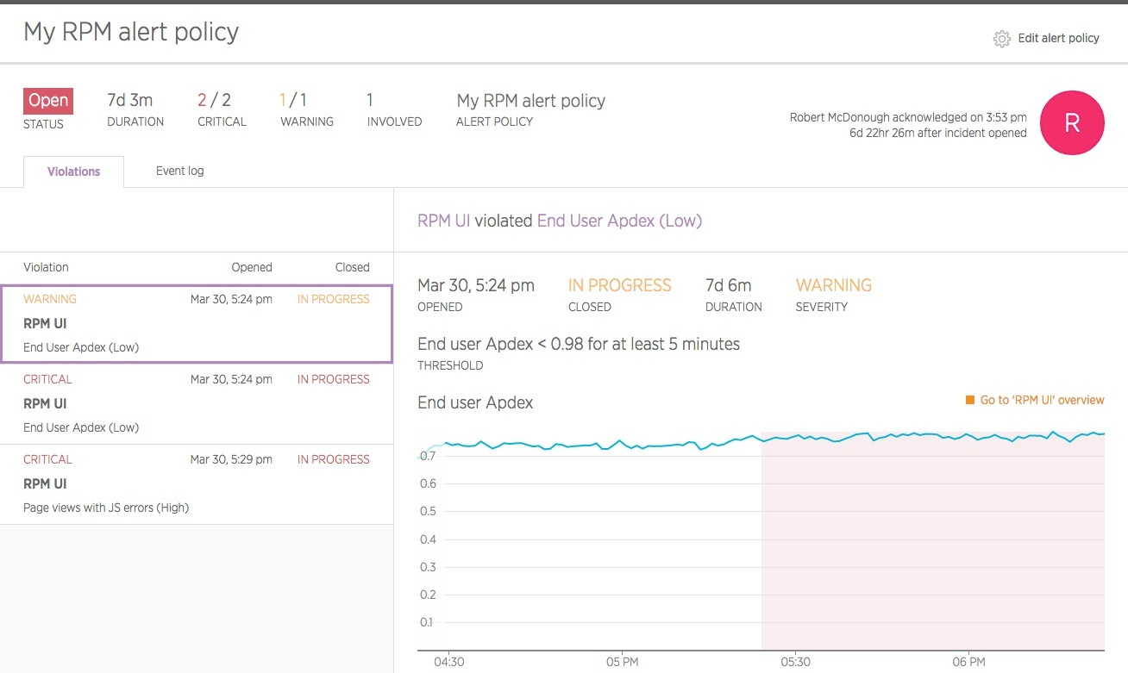
Application Performance
Customer Experience
Business Success
Notes:
Major Alerting improvements
Customers care about this because alerts are one of the primary interfaces that large teams have with our product.

Slide 23
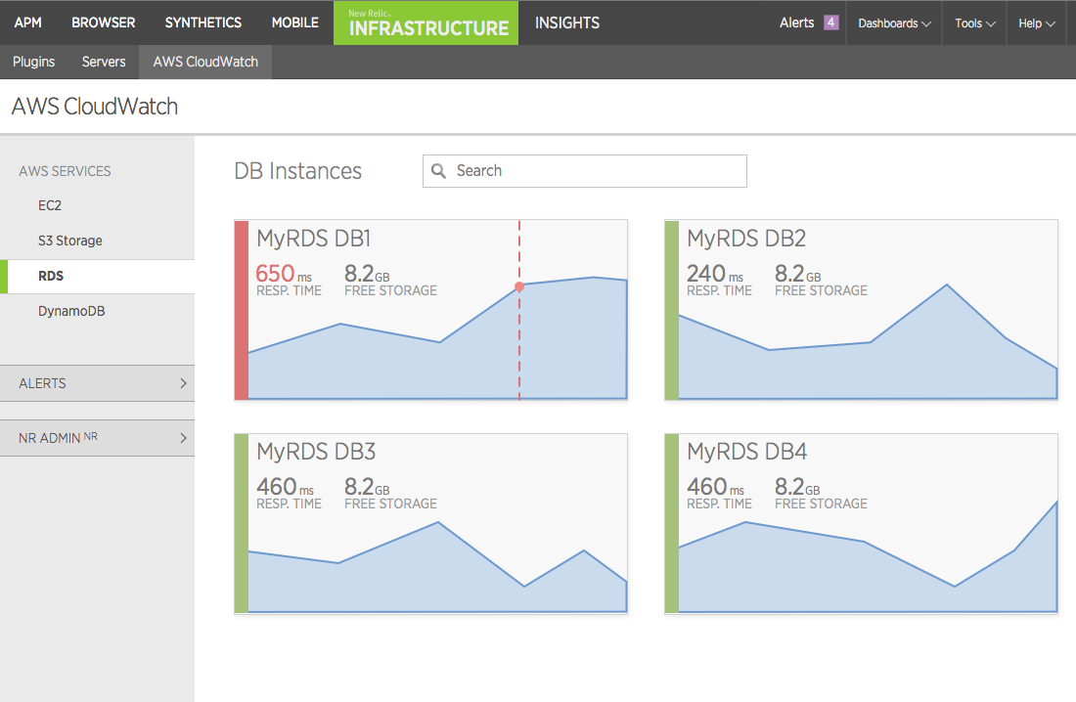
Application Performance
First class AWS support
Notes:
First class AWS support
Customers on AWS care about this because they want to correlate AWS data with the rest of the information they’re tracking in New Relic.

Slide 24
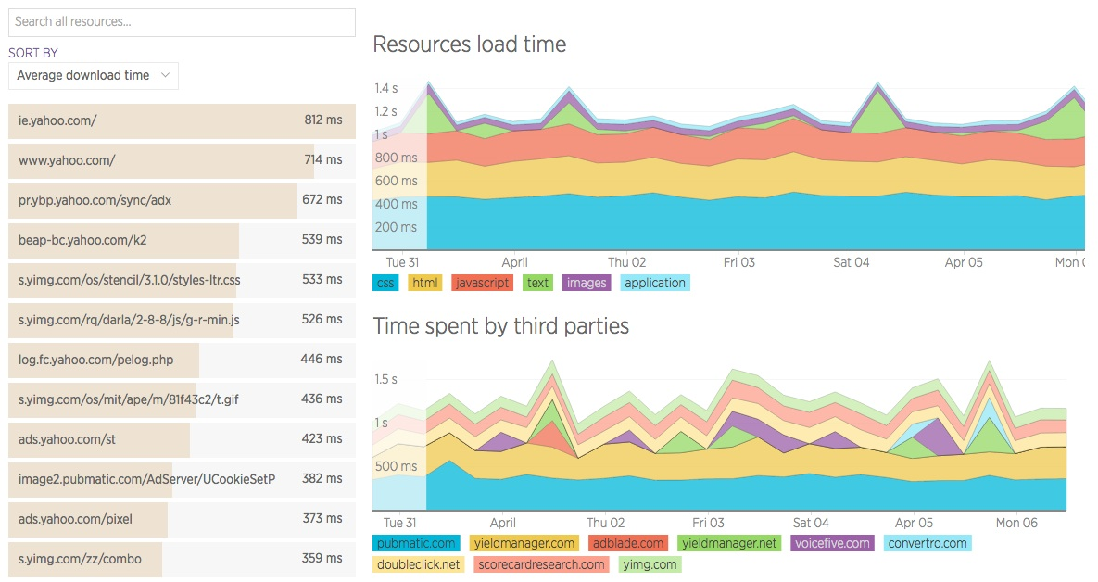
Customer Experience
Customer Experience
Notes:
Browser Aggregate resource timing
Customers care about this because their web pages use dozens of third party services (such as tags and CDNs) and a problem in one of these services can affect their site.
Their web pages are complex, similar to their back-end systems.

Slide 25

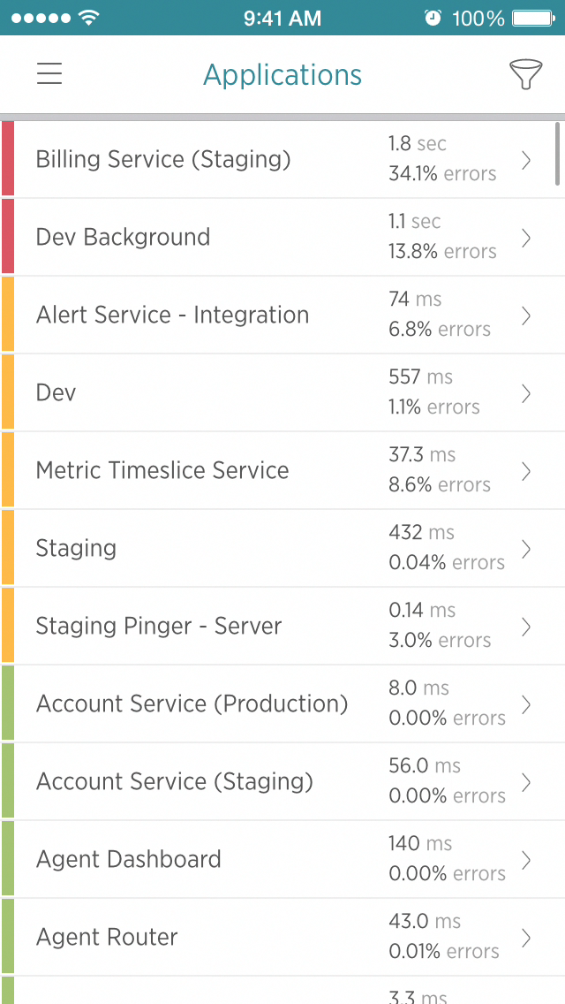
Customer Experience
Notes:
Mobile gestures
Customers care about this because mobile is critically important and the more information they can get about what users are doing the more they can improve the experience.

Slide 26
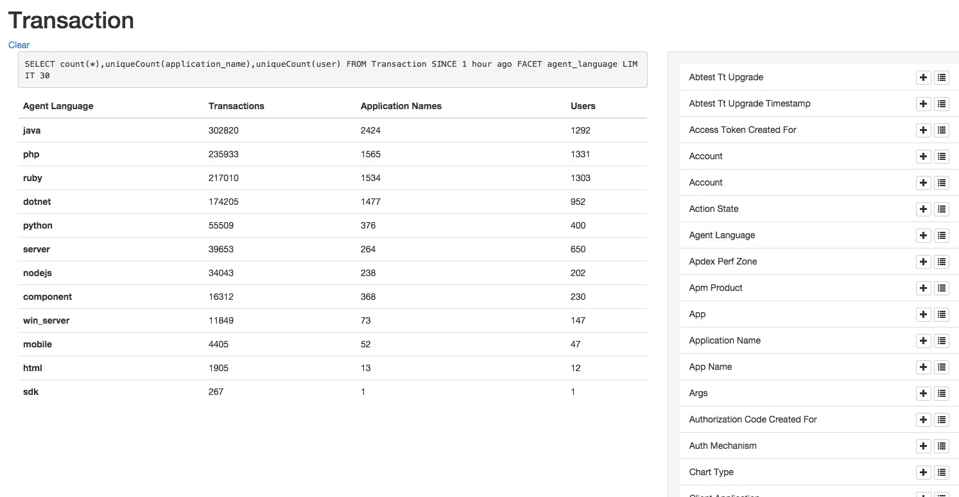
Customer Experience
Business Success
Notes:
Pivot Visual Data Explorer
Customers care about this because they want to navigate and explore insights data without having to learn NRQL. This makes Insights more approachable by non technical users.

Slide 27
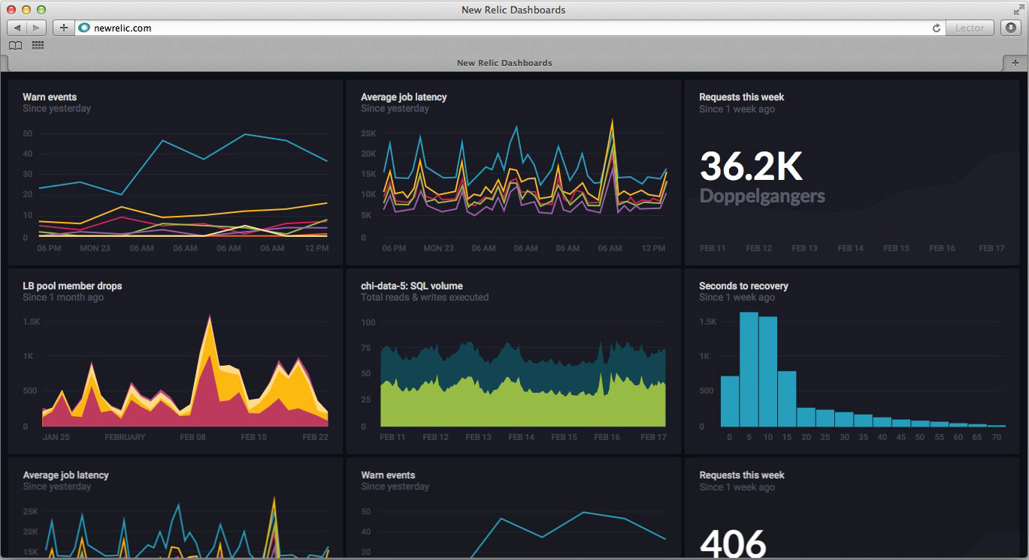
Business Success
Notes:
Dashboards
Customer care about this because they want to create dashboards of data that’s important to them and this data can come from many different systems, like New Relic, SFDC, Zendesk, Marketo.
We believe this will be a paid SKU.

Slide 28
Product First
Customer Value
Pure SaaS
Ubiquity
28
Notes:
Roadmaps are great, but....
More important than any roadmap is this. There is nobody in our market that has ANY of these principles, let alone all three. Yes, our competitors have features that we don’t, but in the long term we will have those features, and more, and these core principles are why we will win.”
I believe one company will emerge as the clear winning in our market. And I believe that company will be New Relic.

Slide 29
ass!
SaaS!
Let’s kick some

